Slide 1

European Bank Loan Marketing Campaign Insights
Our mission: empower you to unleash the maximum potential of your business through unmatched partnership
ASSUMPTIONS
- Each row in the data is a unique client
- Goal is to increase net profit
Thomas Steiner

Slide 2
You asked us to review your marketing campaign
Which clients will be receptive to the marketing campaign?
More term deposit loan subscribers → Increased revenues
More calls to clients → Increased expenses
Is the current predictive model working?
The model should improve accuracy of predicting Subscribers & Non-Subscribers, with a higher focus on Subscribers

Slide 3
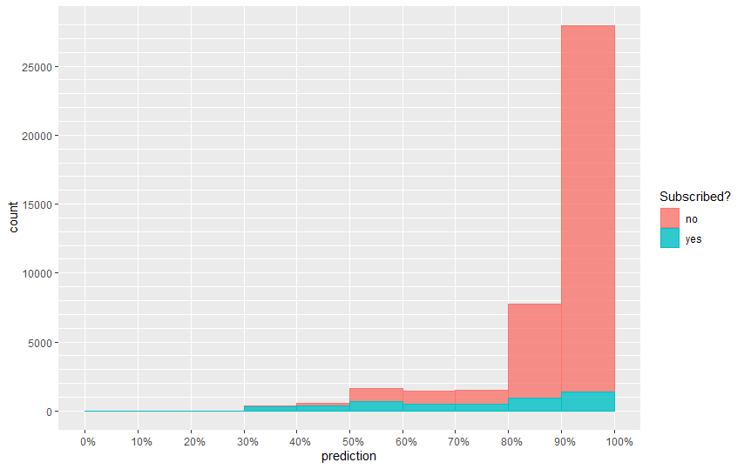
The current model predicts if a client is NOT subscribed to a loan
Number of Subscribers per
current model prediction range
Range | No (not subscribed) | Yes (subscribed)
0 - 10% | 0% | 0%
10 - 20% | 0% | 0%
20 - 30% | 17% | 83%
30 - 40% | 22% | 78%
40 - 50% | 31% | 69%
50 - 60% | 57% | 43%
60 - 70% | 64% | 36%
70 - 80% | 69% | 31%
80 - 90% | 88% | 12%
90 - 100% | 95% | 5%

Slide 4
Is the current model better than no model?
11.3% of your clients are receptive to the marketing campaign
If we predicted all clients are subscribers, we will be correct 11.3% of the time
88.7% maximum accuracy without a model

Slide 5
The current model maximizes prediction accuracy
Accuracy = 89.8% : correct predictions
Sensitivity = 14.7% : correct YES predictions
Specificity = 99.3% : correct NO predictions
Actual
 | Subscribed | Not Subscribed
Subscribed | 680 | 257
Not Subscribed | 3,960 | 36,291
Predicted
The current model focuses on maximizing overall accuracy
Focus should be on maximizing sensitivity

Slide 6
Using a 90% split instead of 50%
Accuracy = 72.5% (-17.3%) : correct predictions
Sensitivity = 70.7% (+56.0%) : correct YES predictions
Specificity = 72.7% (-26.6%) : correct NO predictions
Actual
 | Subscribed | Not Subscribed
Subscribed | 3,282 | 9,966
Not Subscribed | 1,358 | 26,582
Predicted

Slide 7
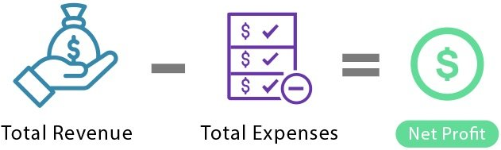
Value added using a net profit approach
100:1 example
Average expenses from 1 phone call = $20
Average revenue from 1 new Subscriber = $2,000
Net profit focus
Accuracy of Subscriber prediction is 100x more important than accuracy of Non-Subscriber prediction

Slide 8

Our plan to apply a net profit approach
1. Net Present Value of forecasted cash flows
Determine potential model improvements
Work with accounting team
Determine average cost per call
Determine average revenue per new subscriber
Calculate NPV of model improvements
2. Project Budget
Compare to project NPV
3. Project timeline

Slide 9
Thank you for choosing Rock Central
Thomas Steiner

